Slide 1
Promoting Data Quality in PEDSnet Using GitHub
Aaron N. Browne, Jeffrey W. Pennington, L. Charles Bailey, MD, PhD
Notes:
happy to be here, presenting on…
did the work for this presentation under Jeff and Charlie, but much less than that done by the PEDSnet collaborators

Slide 2
Disclosures
Nothing to disclose.
Notes:
I have nothing to disclose.

Slide 3
Objectives
Describe PEDSnet EHR data collaboration
Highlight potential data quality issues
Introduce GitHub platform
Report on GitHub usage in PEDSnet
Data Quality improvement?
Future directions
Notes:
I’ll talk about…
What is PEDSnet? What data quality predicted? What is GitHub? How did we use GitHub, did it work? Future…
Jump right in.

Slide 4





Notes:
Familiarity check: heard of PEDSnet? working on PEDSnet?
PCORnet CDRN, all about children.
Baby so sad b/c aggregating data from 8 hospitals with ~70 (dancing?) collaborators.

Slide 5
PEDSnet
2.1 million patients
2.8% of US children
22 state catchment area
Forrest, Christopher B., et al. “PEDSnet: a National Pediatric Learning Health System.“ Journal of the American Medical Informatics Association (2014): amiajnl-2014.
Notes:
Fantastic potential for research.
Currently aggregating and making data available.

Slide 6
Data Quality
EHR-inherent issues:
Accuracy
Objectivity
Believability
Extraction and transformation issues:
Completeness
Mis-representation
Kahn, Michael G., et al. “A pragmatic framework for single-site and multisite data quality assessment in electronic health record-based clinical research.” Medical care 50 (2012).
Notes:
Great potential; many potential problems.
EHRs are filled with inaccurate, non-standard, and just made up data.
ETL processes can suffer from incompleteness and general data model errors.
Hang on to this for a second!

Slide 7
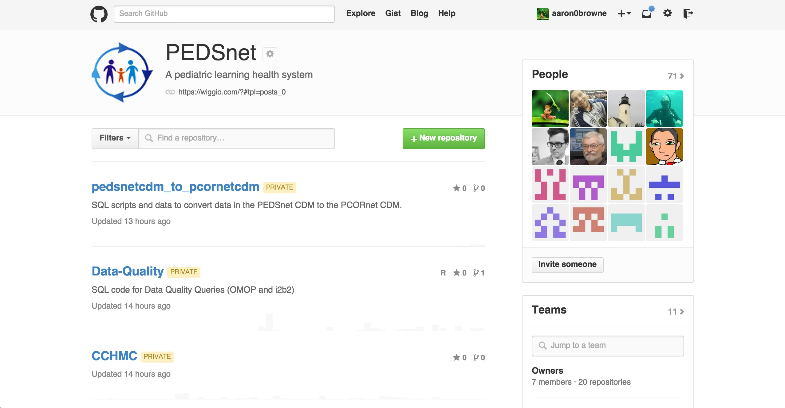


Notes:
Familiarity check: Version control systems? Heard of git/GitHub? GitHub users?
Git was developed by Linus Torvalds, the “father of Linux”, to manage the Linux kernel. GitHub is a recent social web collaboration tool built around it.
PEDSnet uses GitHub to collaborate (private for now). Email and web notifications. “Feed view” and many other angles.

Slide 8
PEDSnet on GitHub
71 members
11 teams
20 repositories
Workflow:
Issues
Comments
Commits
Pull Requests
Notes:
Teams for permission control.
Repos are focused code/doc packages: 8 for sites, others for query distribution and various operations and documentation.
Lines of code not measured b/c XML and false church of LOC.

Slide 9
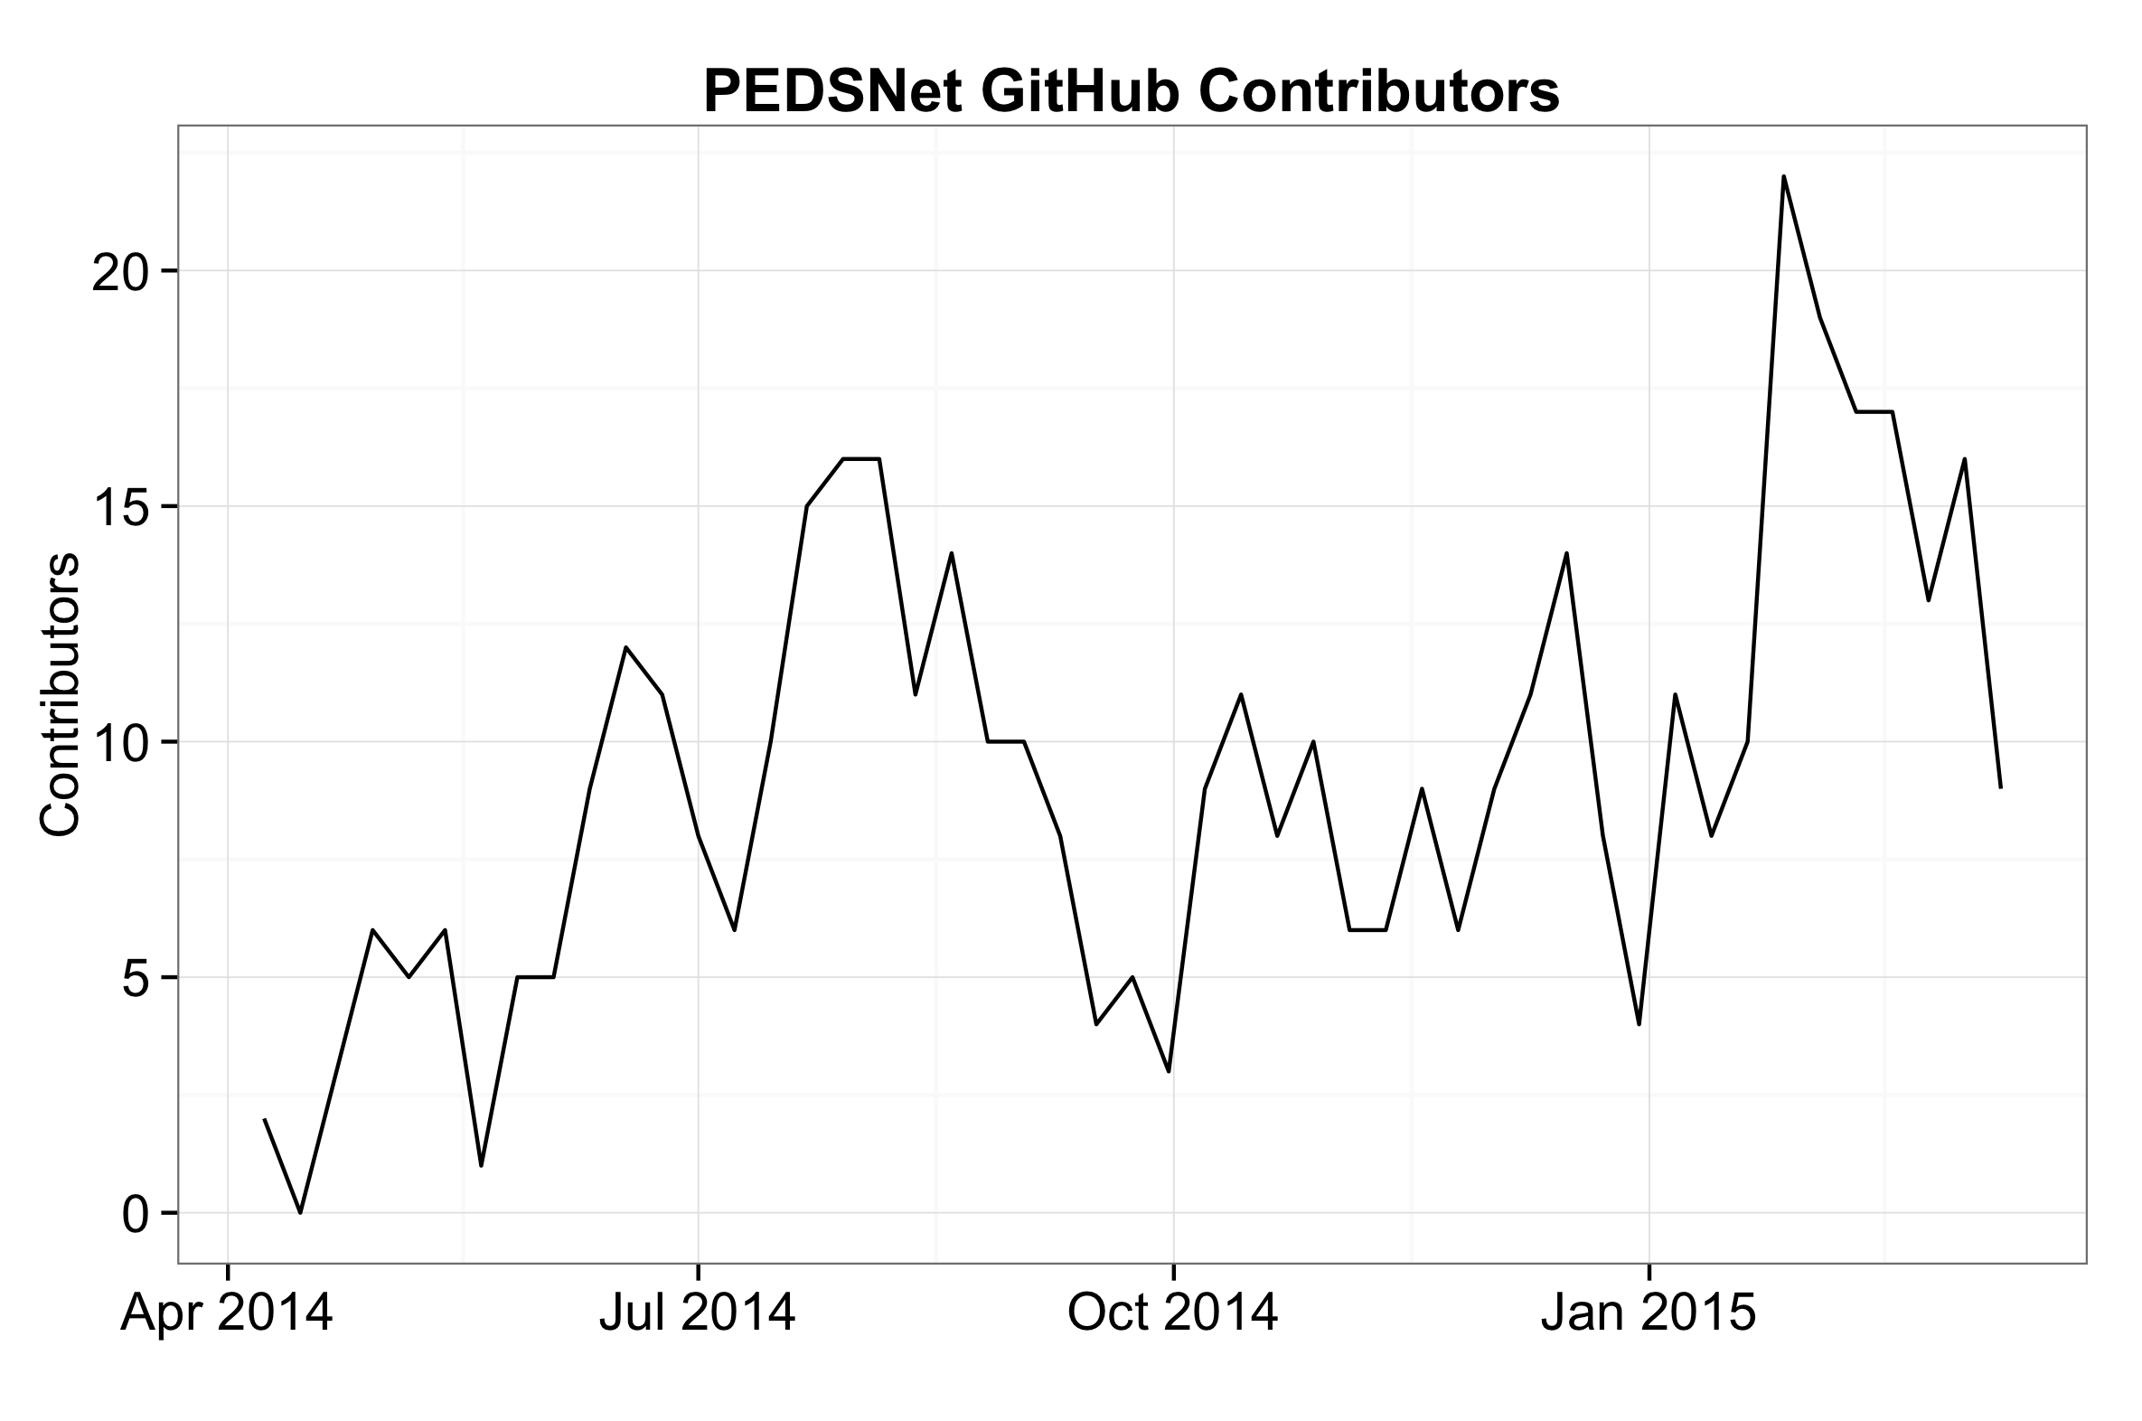


Contributors
Notes:
Opened an issue, authored a comment, closed an issue, authored a commit in that week.
Periodic peaks, general increase.
Represents all levels of management and developers. Michael Kahn and I.

Slide 10
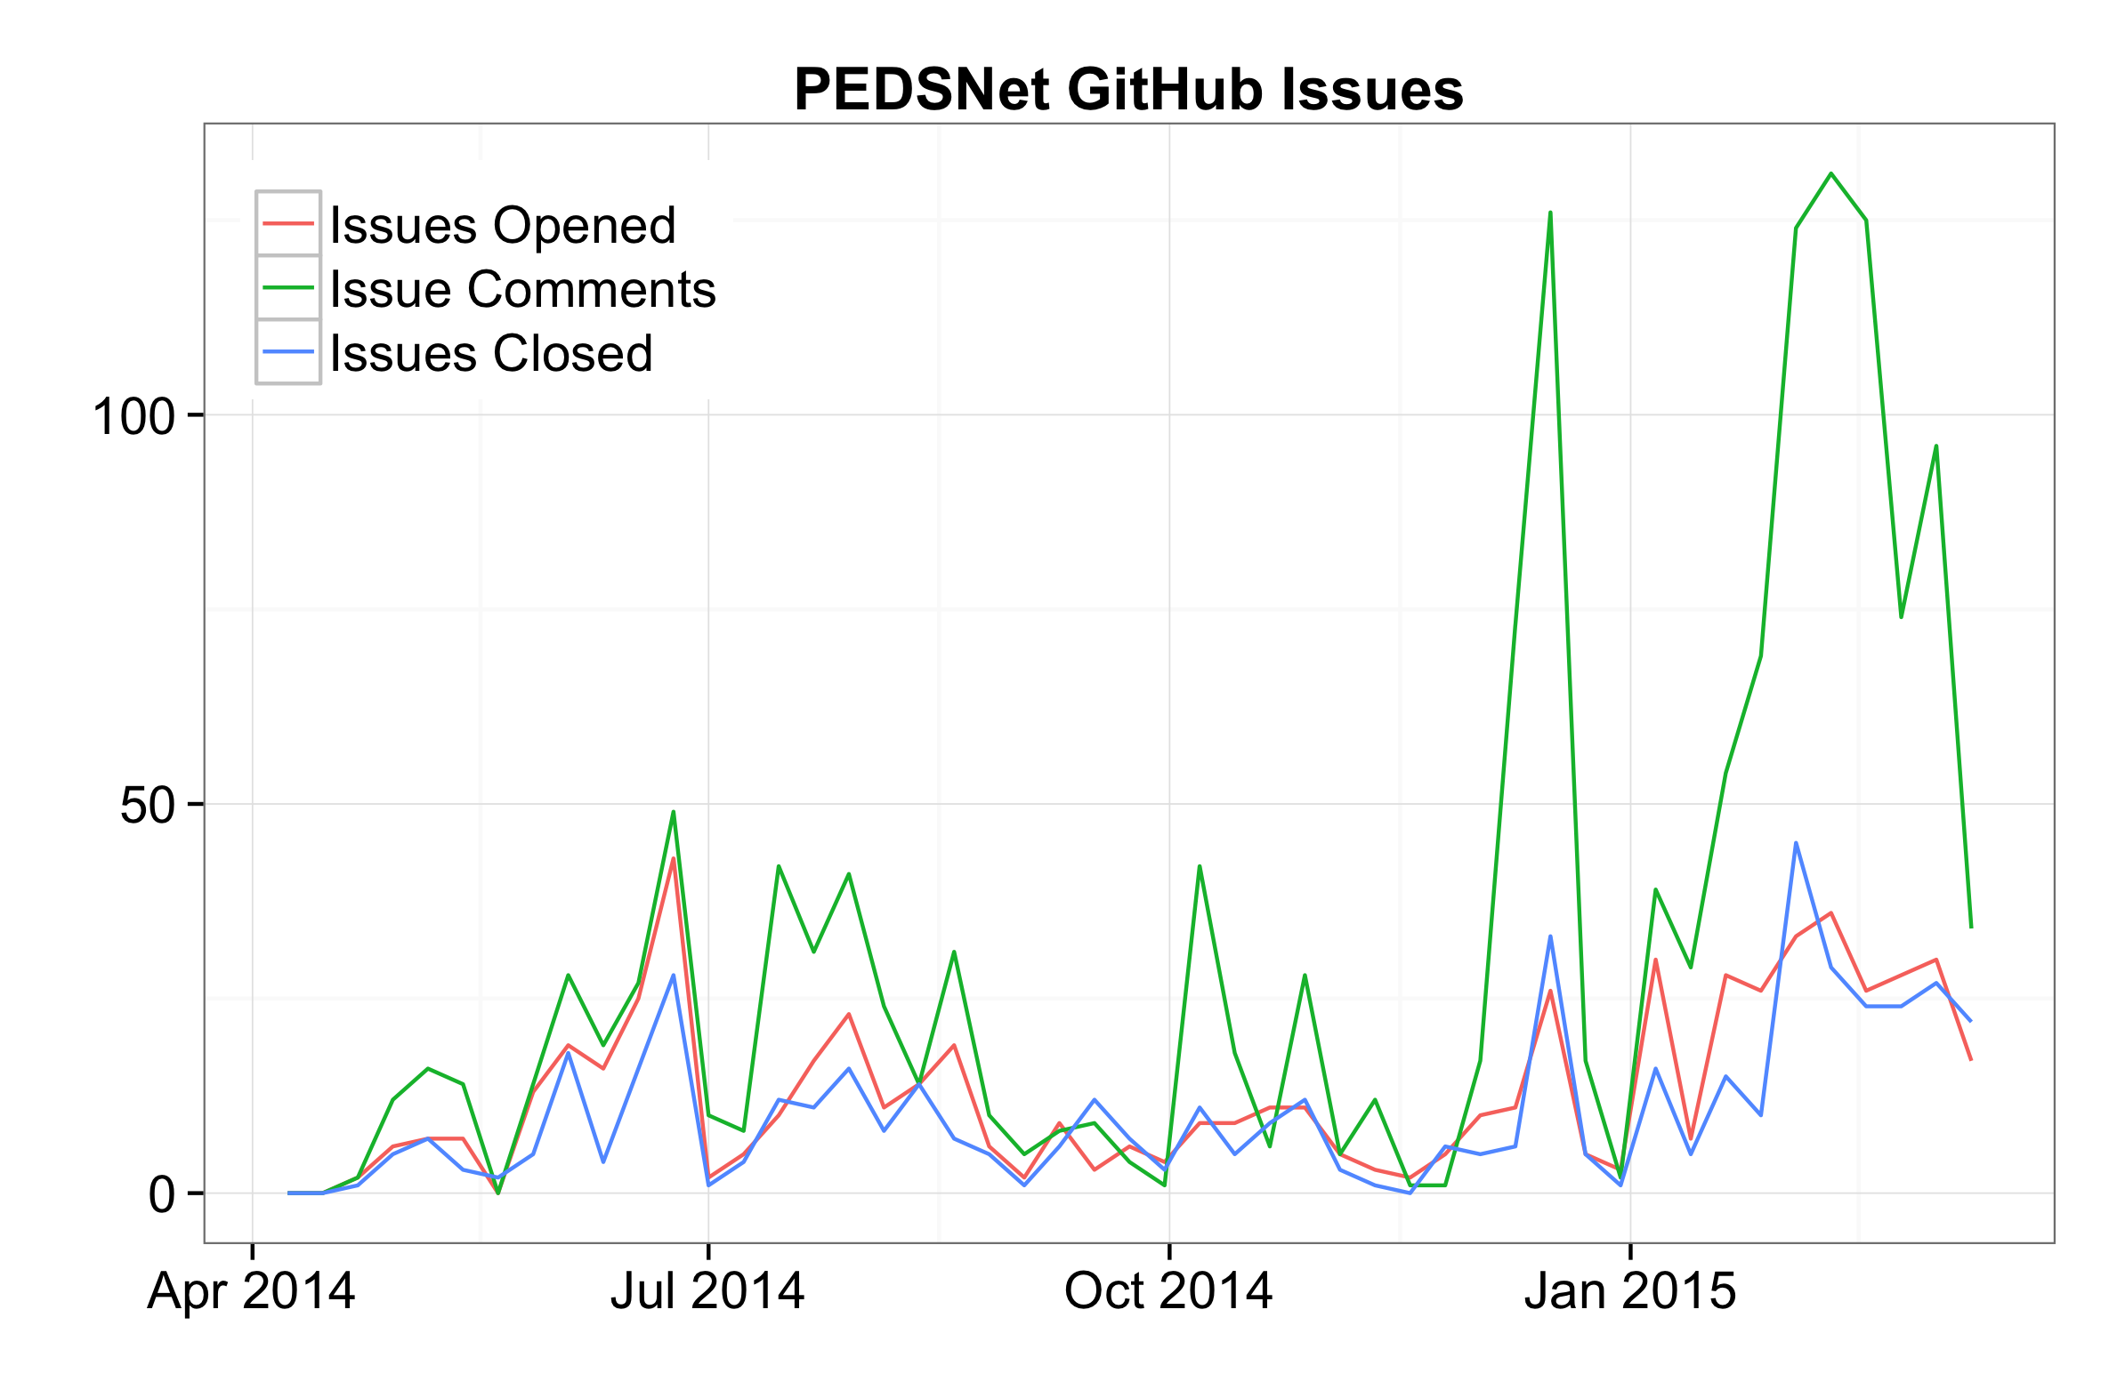

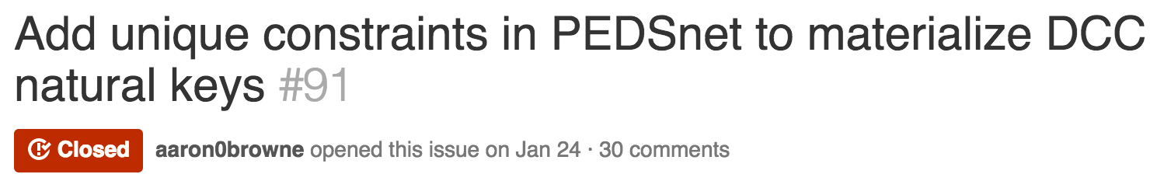


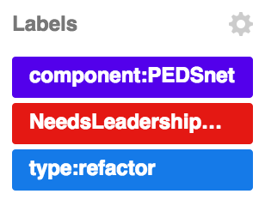
Issues
Notes:
Again, per week. High number of comments is great.
Some favorites and most commented…
Other issues tackled: case sensitivity, timezone support, data transfer feedback, data quality code dbms compatibility
Favorite comment: 721 words about stable person identifiers from Charlie Bailey, and it starts with…

Slide 11
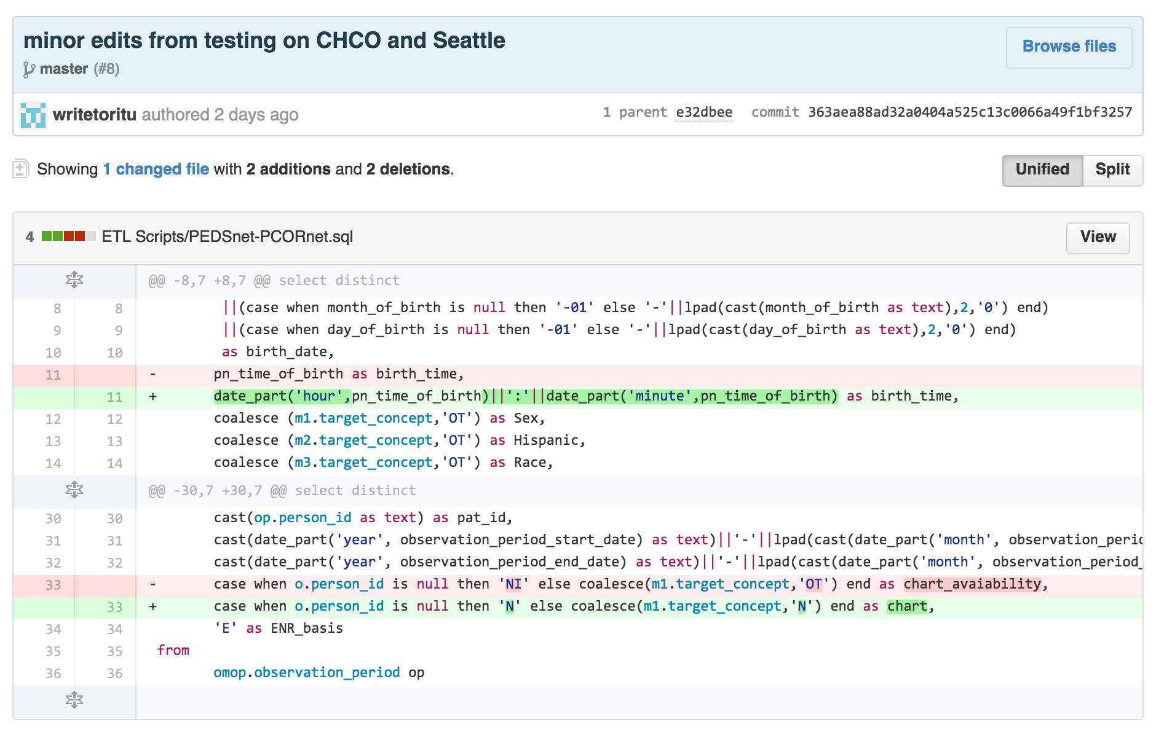
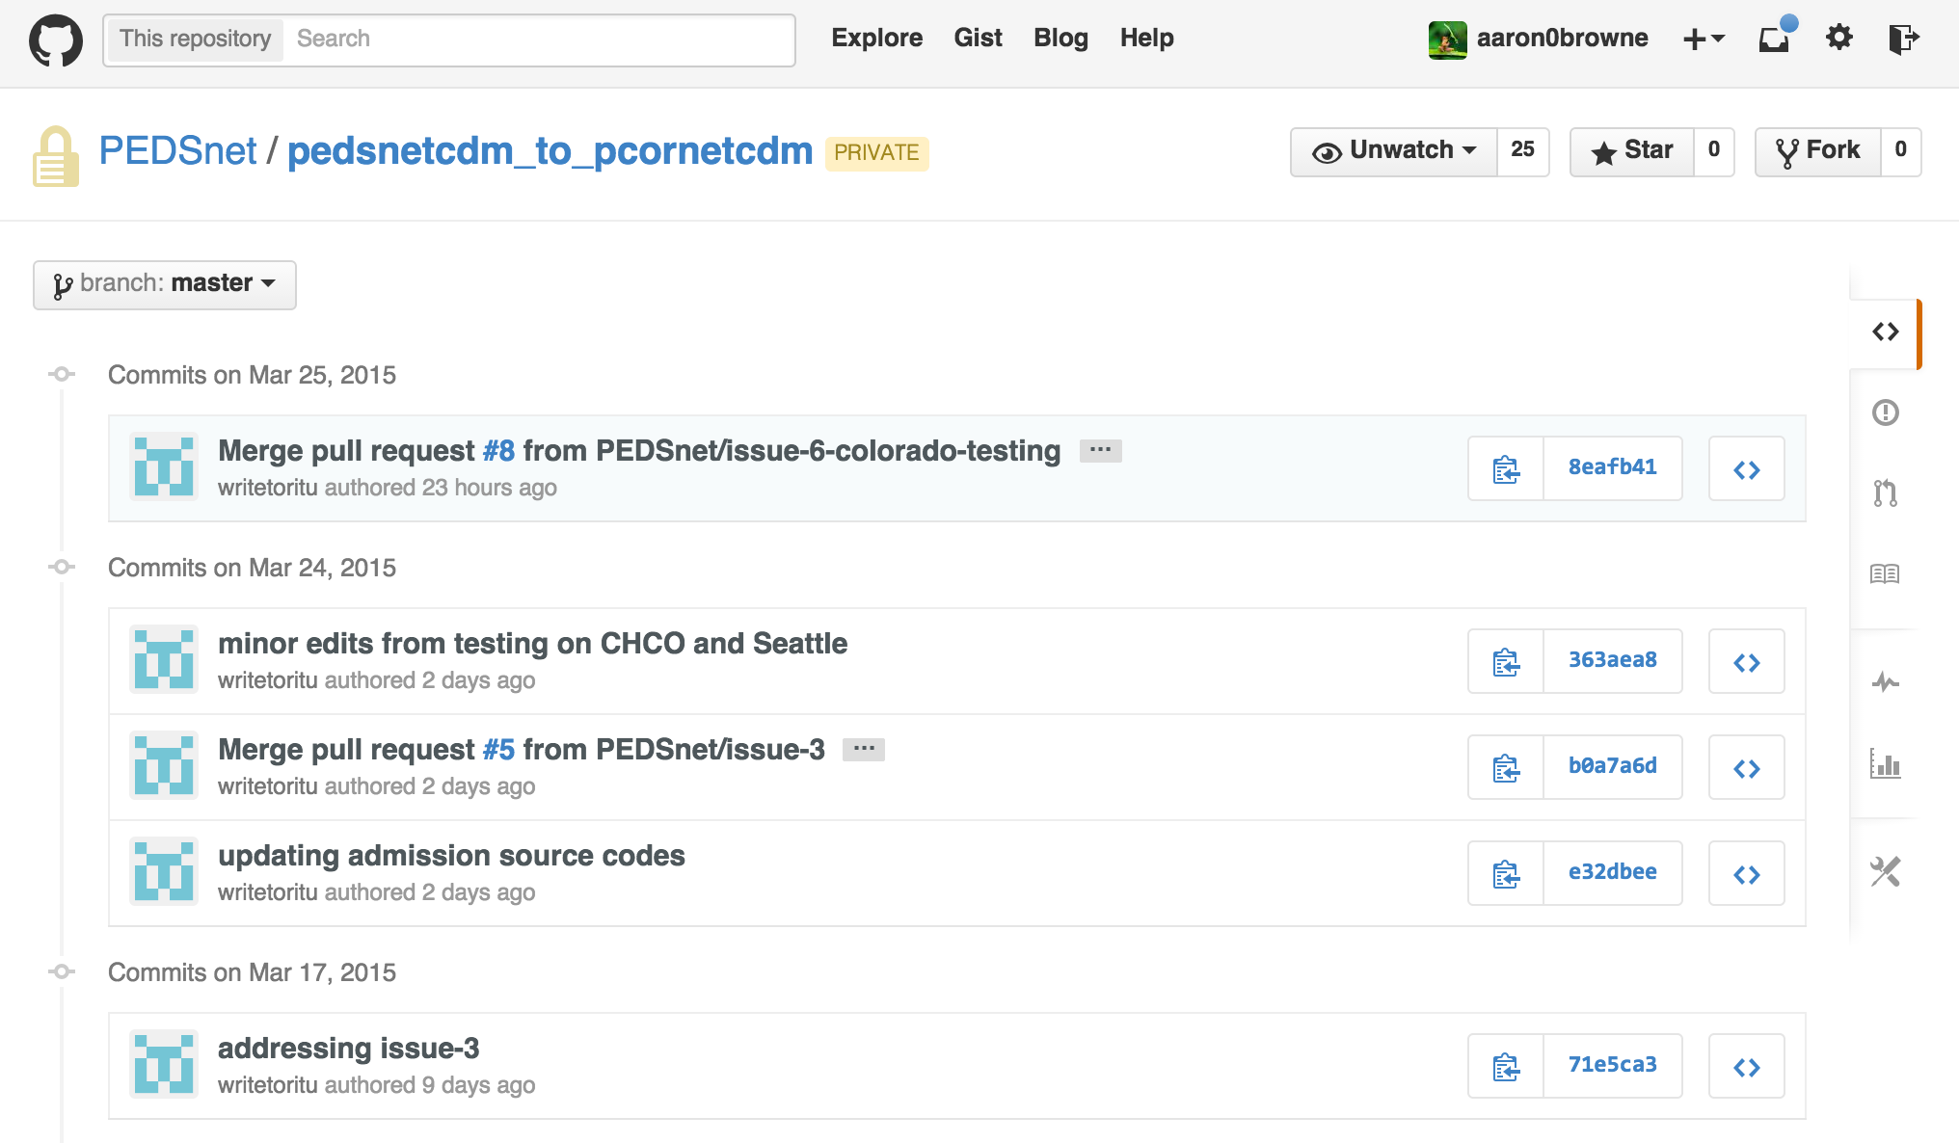
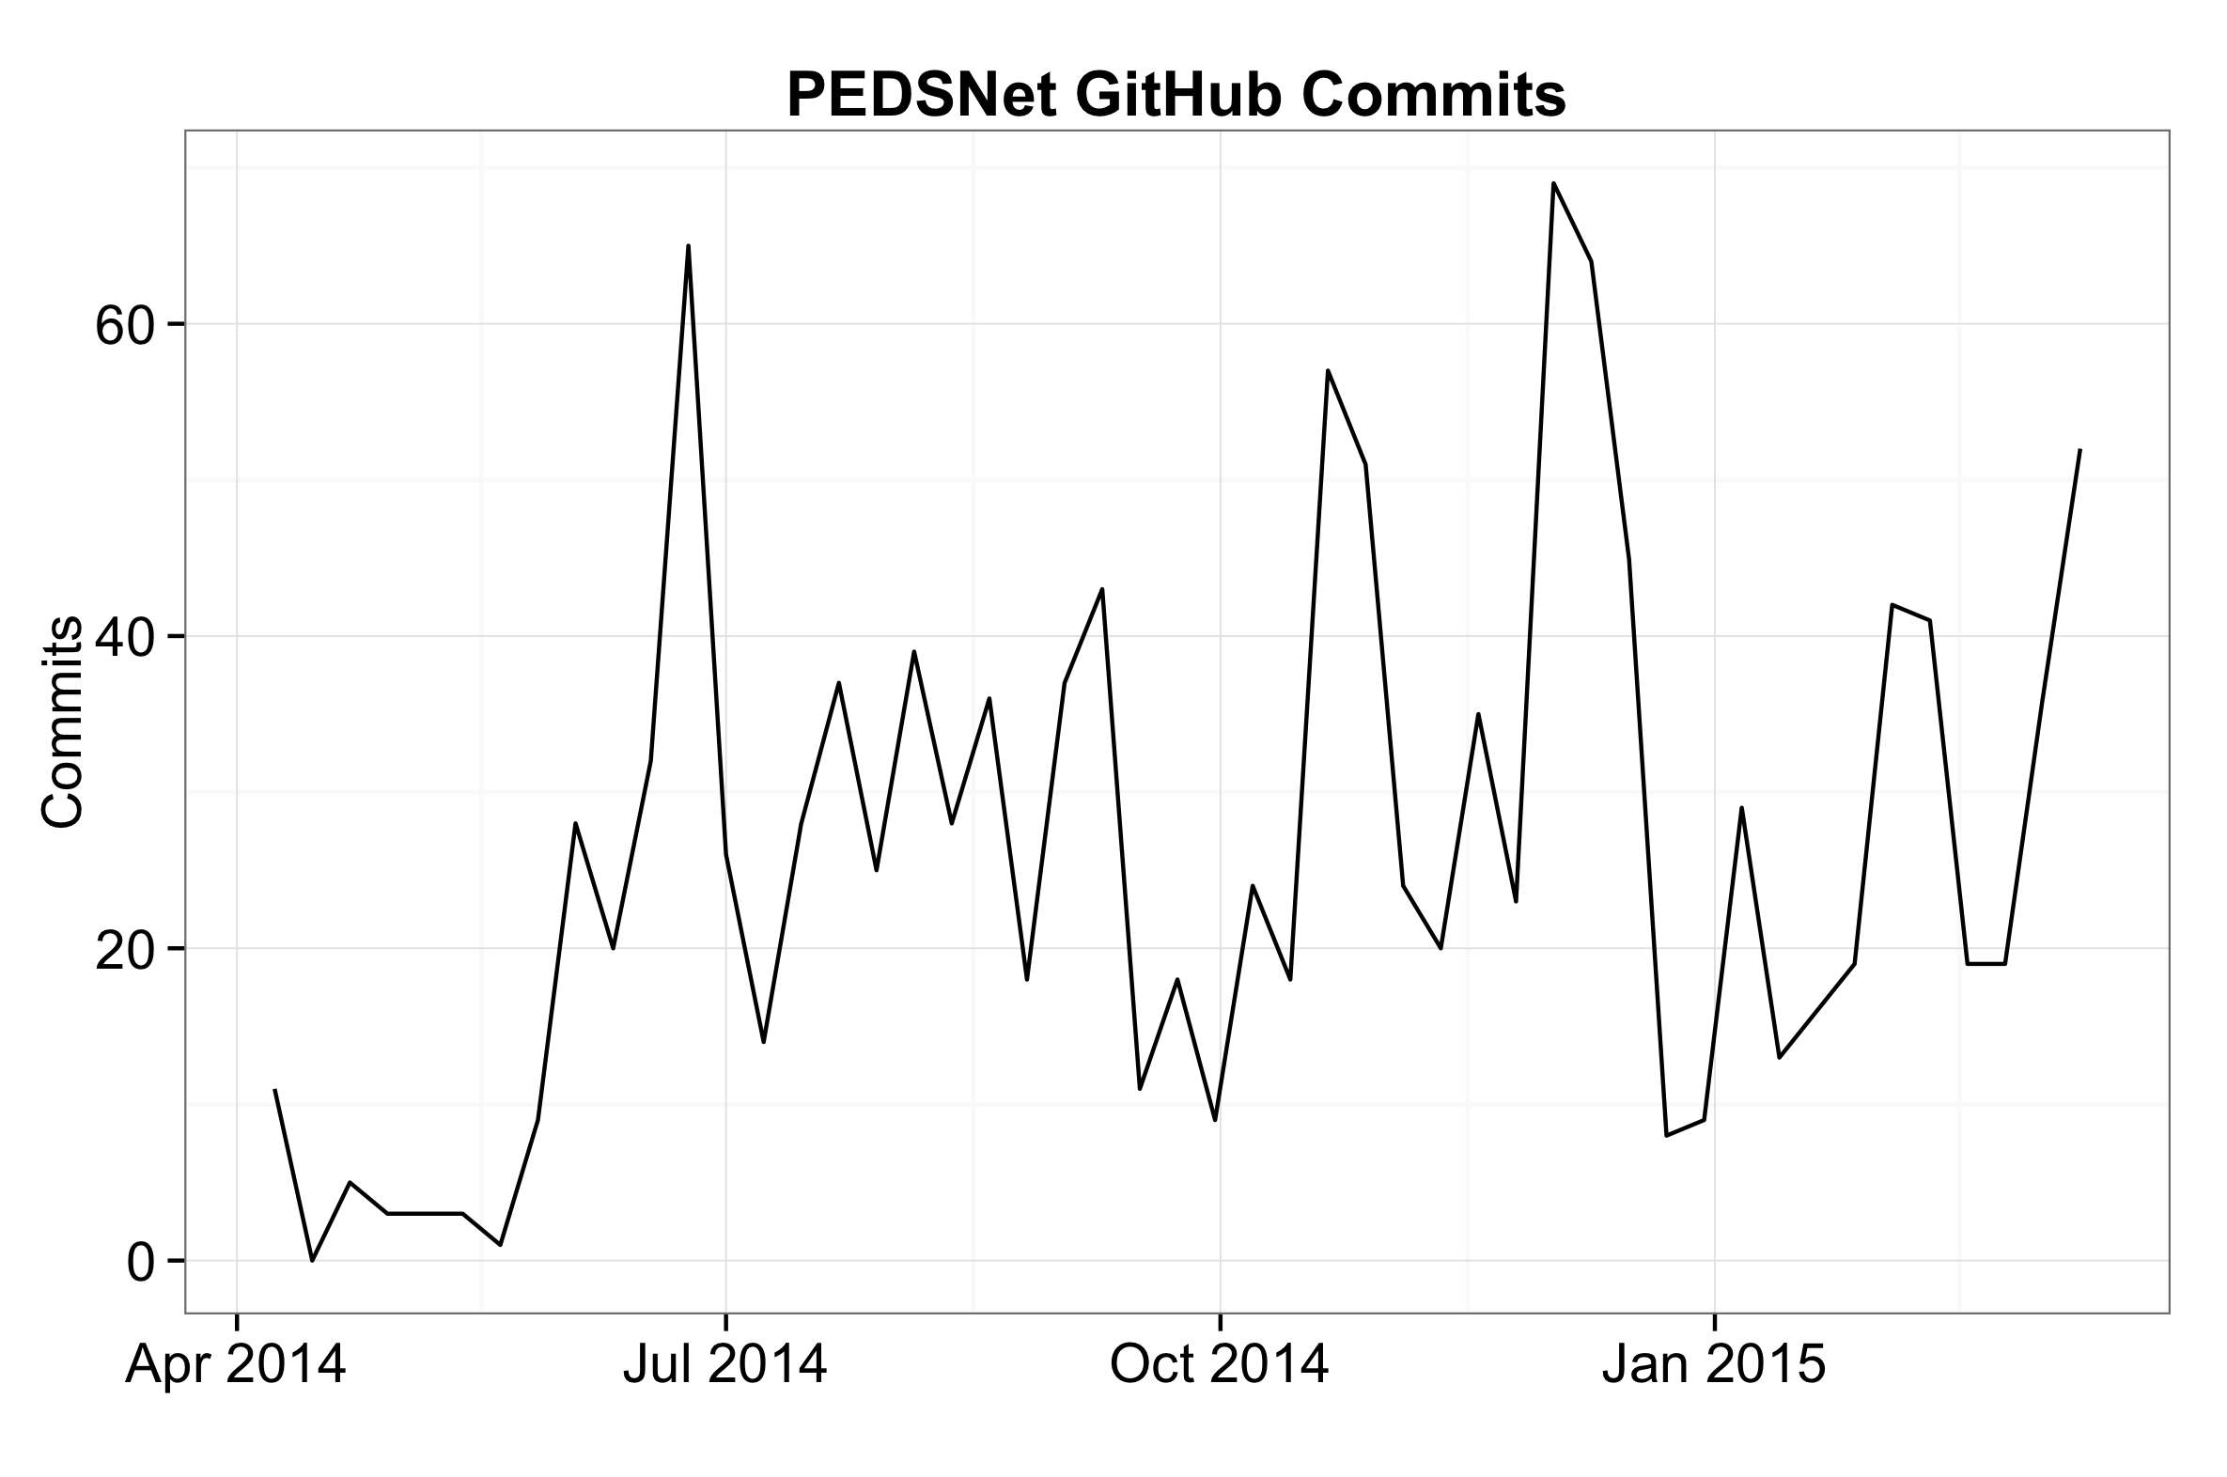
Commits
Notes:
Again, typical periodicity, but rising; good.
An example of commit list from internal PEDSnet CDM to PCORnet CDM transformation code.
An example commit change view.

Slide 12
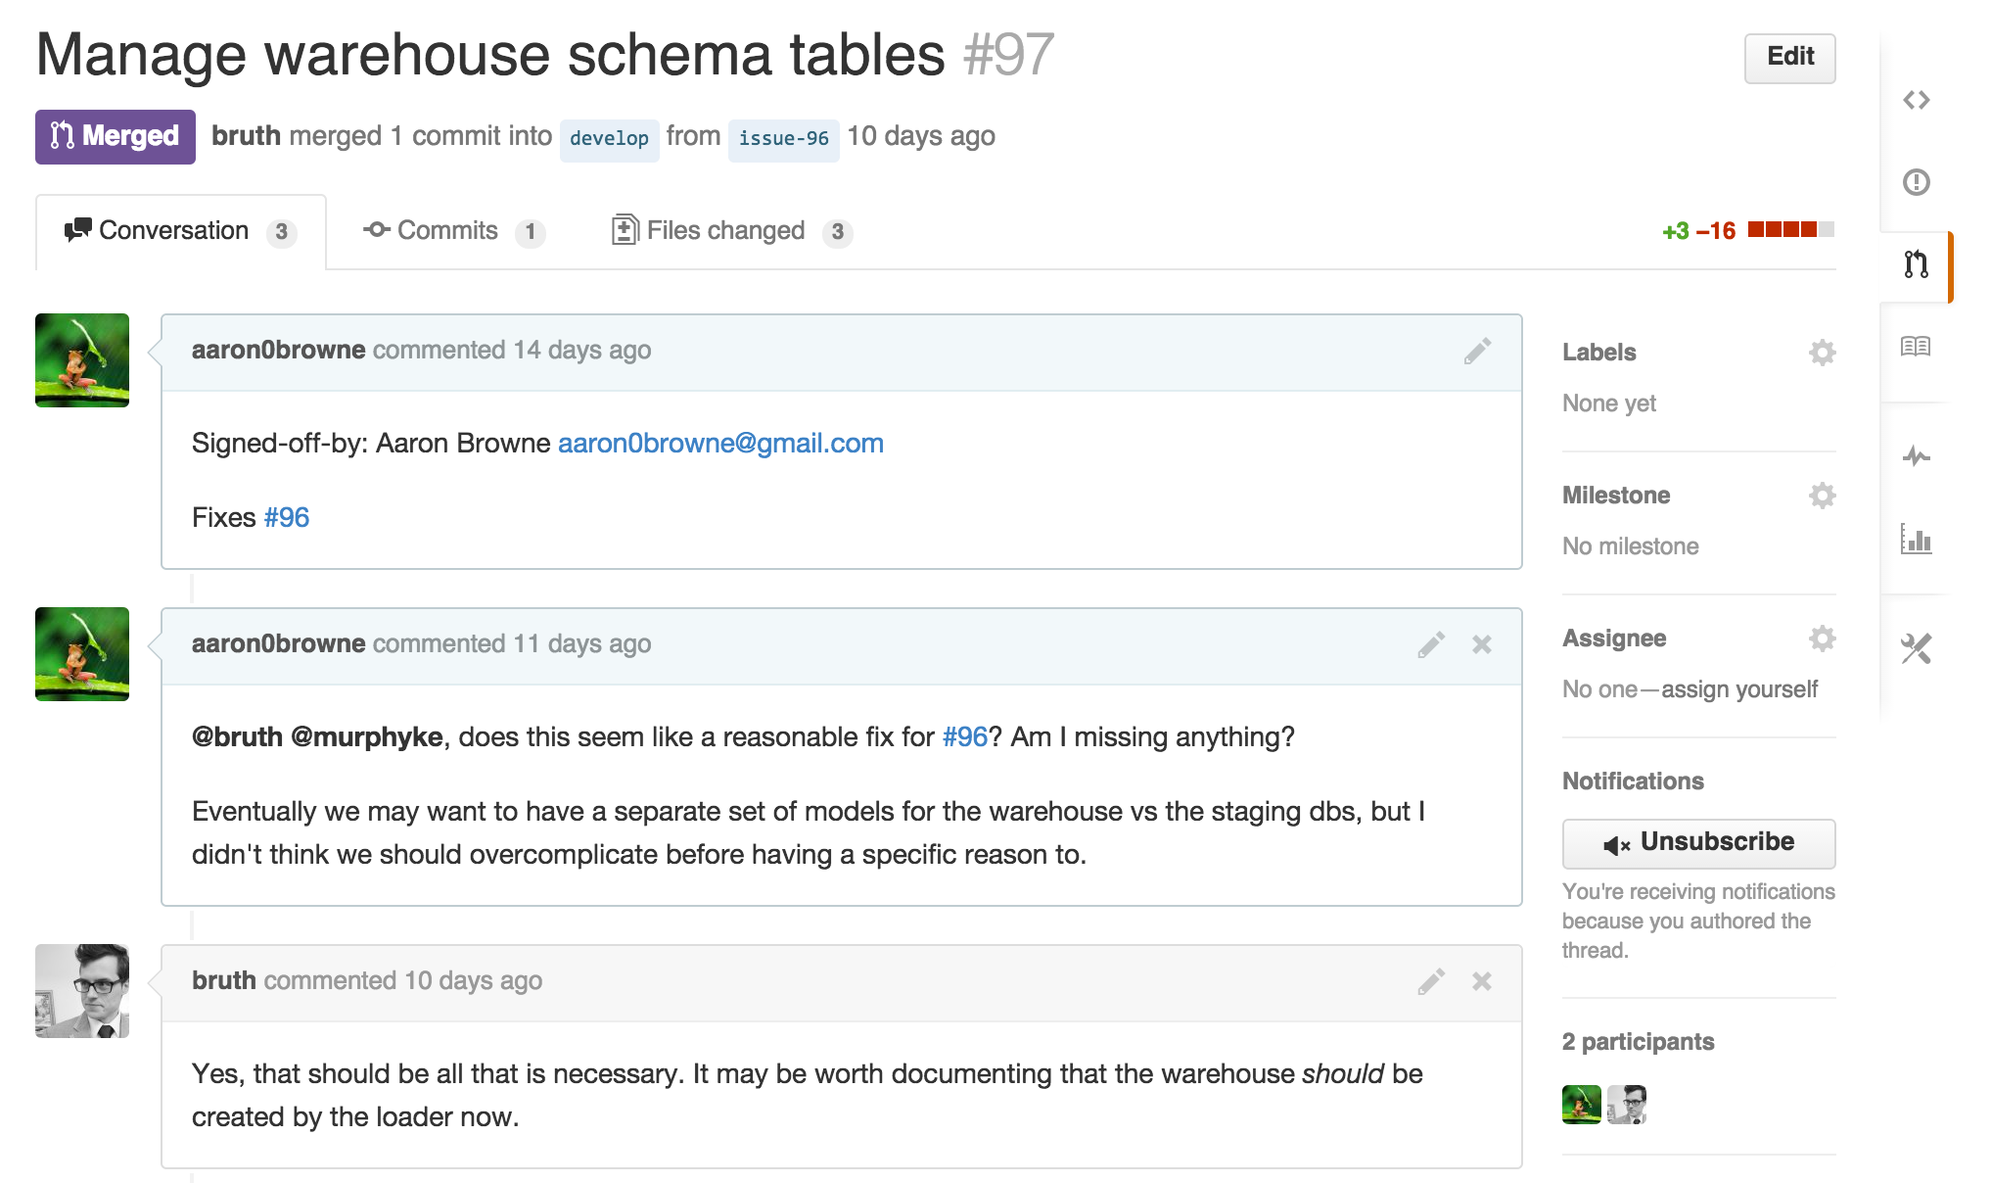
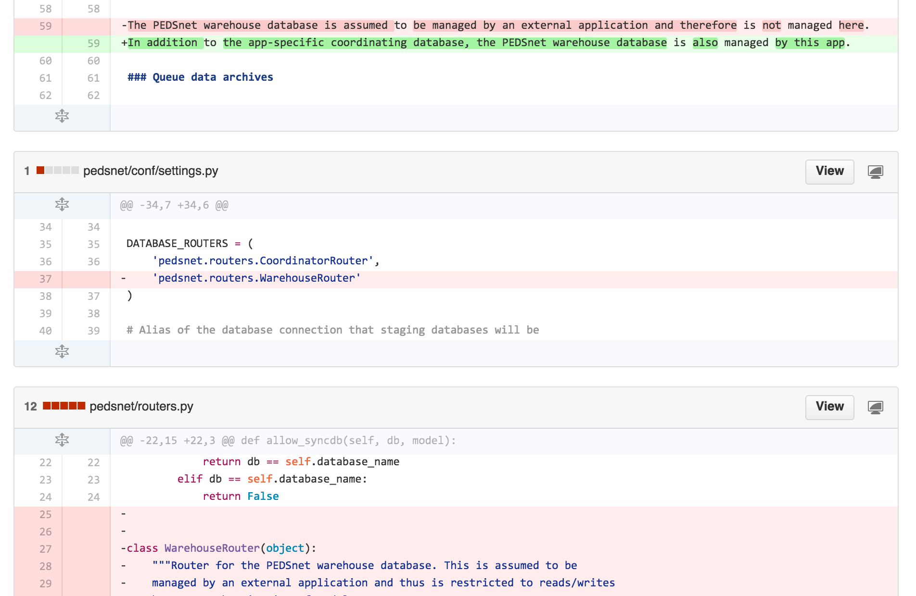
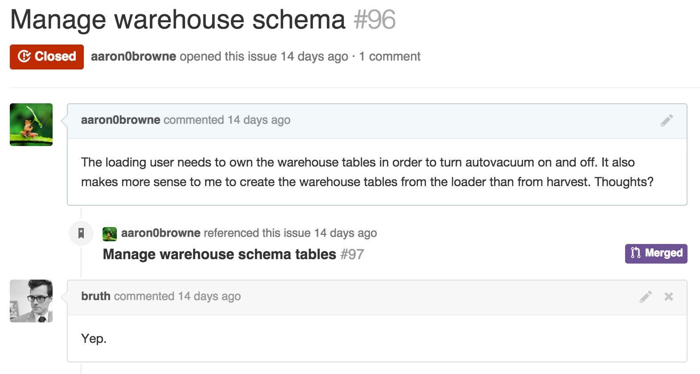
Workflow Example
Notes:
Didn’t report on PRs, b/c its more advanced, but here’s an example from an internal DCC repo.
Comment, PR, changes: documentation and code changes at the same time.

Slide 13
Conclusions
Data quality results:
Early distribution and debugging of DQ tools
Early and often code reviews
Convention discussion and distribution
Transparency!
Future work:
Re-use GitHub data for end-user trust

Slide 14

Questions?
supported by PCORI Contract CDRN-1306-01556

